Slide 1
Reduction on the GPU
1

Slide 2
Problem statement
●
Given a nonempty array of floats or ints, compute the sum of all elements of the array
Basic idea
●
–
–
–
Decompose the problem across thread blocks Each thread block computes a partial reduction The CPU completes the reduction
2

Slide 3
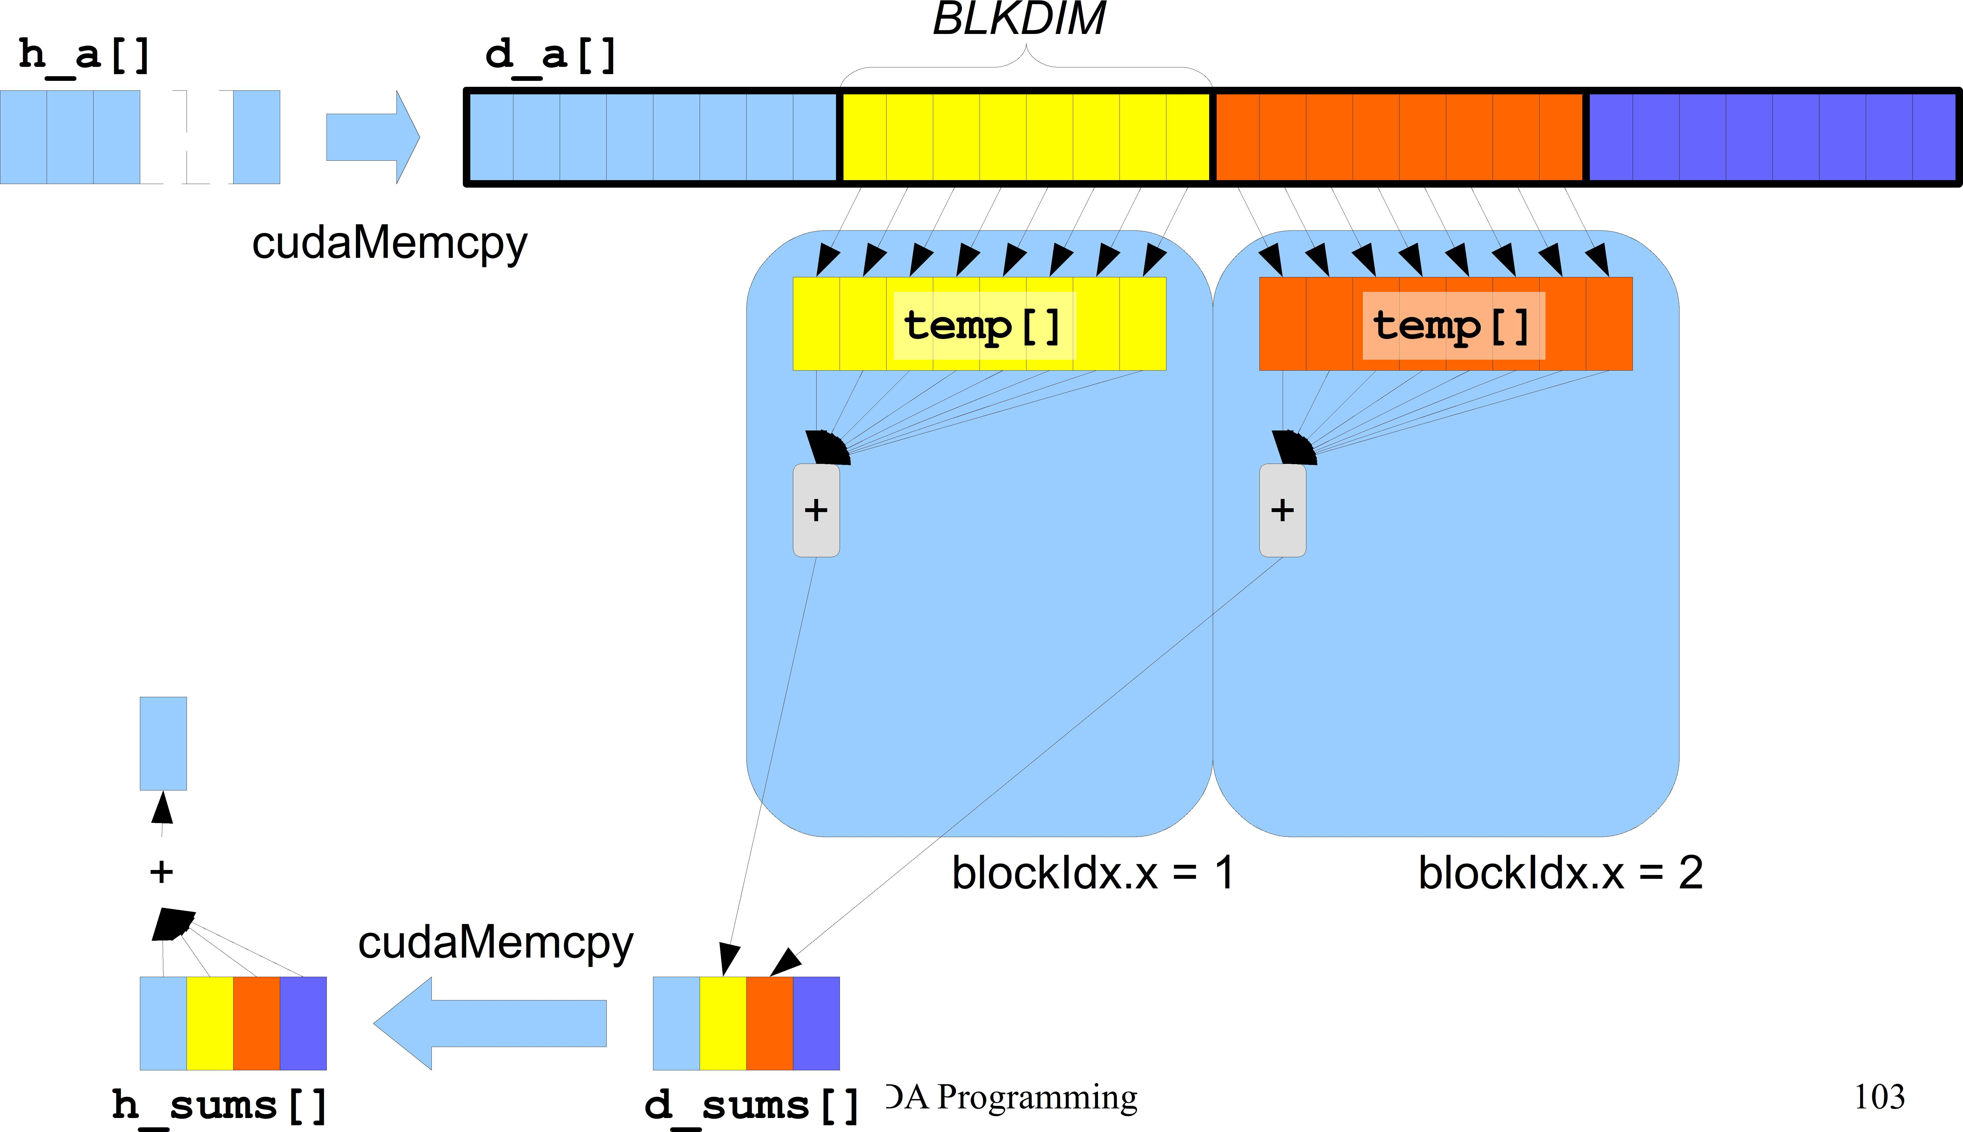
Solution #0 (naive)
Thread 0 of each block computes the local sum
●

Slide 4
Solution #0 kernel
#define BLKDIM 512
#define N_OF_BLOCKS 1024
#define N ((N_OF_BLOCKS)*(BLKDIM))
device int d_sums[N_OF_BLOCKS];
int h_sums[N_OF_BLOCKS];
Shared memory is not useful here; it will be
global void sum( int *a, int n )
{
shared int temp[BLKDIM]; int lindex = threadIdx.x; int bindex = blockIdx.x;
useful in the other
versions of this kernel
int gindex = threadIdx.x + blockIdx.x * blockDim.x; temp[lindex] = a[gindex];
syncthreads();
if ( 0 == lindex ) {
int i, my_sum = 0;
for (i=0; i<blockDim.x; i++) { my_sum += temp[i];
}
d_sums[bindex] = my_sum;
}
}
CUDA Programming
104
See cuda-reduction0.cu

Slide 5
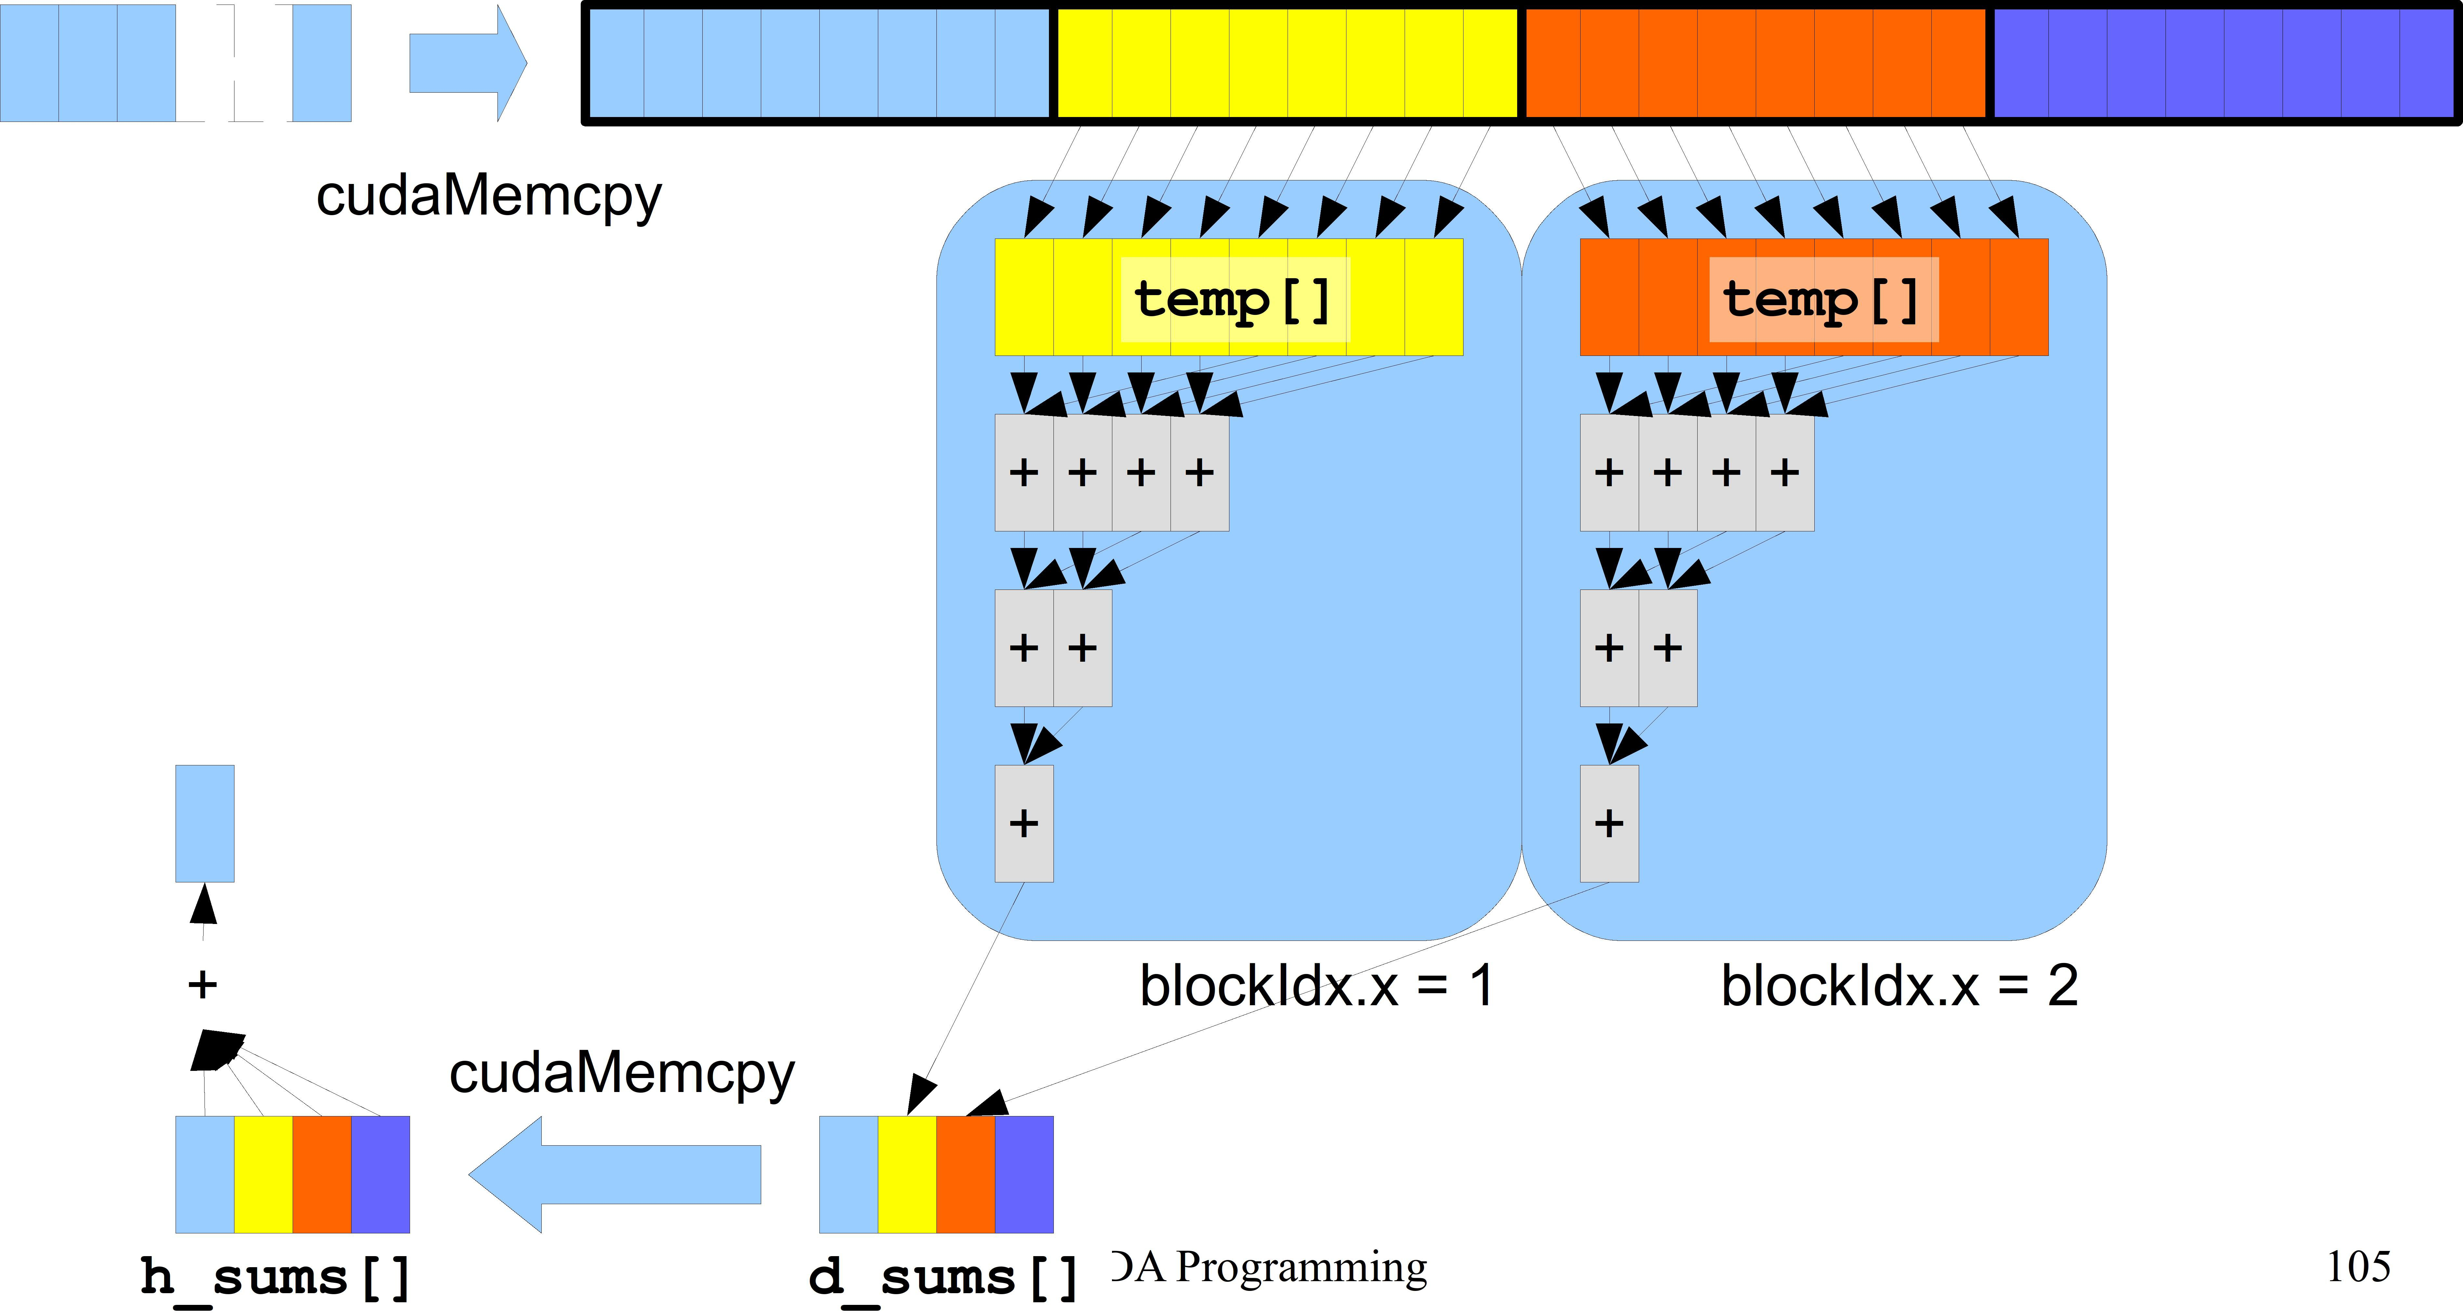
Solution #1 (better)
●
All threads within each block cooperate to compute the local sum
h_a[] d_a[]

Slide 6
Solution #1 kernel
This kernel only works if
global void sum( int *a, int n )
{
shared int temp[BLKDIM]; const int lindex = threadIdx.x; const int bindex = blockIdx.x;
●
●
BLKDIM is a power of two;
n is a multiple of BLKDIM
const int gindex = threadIdx.x + blockIdx.x * blockDim.x;
int bsize = blockDim.x / 2; temp[lindex] = a[gindex];
syncthreads(); while ( bsize > 0 ) {
if ( lindex < bsize ) {
temp[lindex] += temp[lindex + bsize];
}
bsize = bsize / 2;
syncthreads();
}
if ( 0 == lindex ) { d_sums[bindex] = temp[0];
}
}
See cuda-reduction1.cu
CUDA Programming 106

Slide 7
Atomic operations with CUDA
7

Slide 8
Atomic functions
●
Perform read-modify-write operations on one 32- or 64-bit word in global or shared memory
The operation is guaranteed to be atomic Example:
●
●
– Each thread adds 3 to the content of the memory location a a must point to a valid address in global or shared memory
–
global void my_kernel( int *a )
{
atomicAdd(a, 3);
}
8

Slide 9
Atomic functions
●
Many atomic functions are polymorphic
i.e., they work for items of different types
atomicAdd() works for items of type int, unsigned int, float, double, and others
Not all functions support the same types Check the documentation:
●
●
https://docs.nvidia.com/cuda/cuda-c-programming-gui de/index.html#atomic-functions
9

Slide 10
Atomic functions
int atomicAdd(int* addr, int val);
int old = *addr; *addr += val; return old;
int atomicSub(int* addr, int val);
int old = *addr; *addr -= val; return old;
int atomicExch(int* addr, int val);
int old = *addr; *addr = val; return old;
int atomicMin(int* addr, int val);
int old = *addr; *addr = min(*addr, val); return old
int atomicMax(int* addr, int val);
int old = *addr; *addr = max(*addr, val); return old
int atomicCAS(int* addr, int cmp, int val);
int old = *addr; *addr = (old == cmp ? val : old); return old;
...and others
●
●
●
●
●
●
●

Slide 11
Reduction with atomic operations
global void sum( int *a, int n, int *result )
{
shared int temp[BLKDIM];
int lindex = threadIdx.x;
int gindex = threadIdx.x + blockIdx.x * blockDim.x;
int bsize = blockDim.x / 2; temp[lindex] = a[gindex];
syncthreads();
while ( bsize > 0 ) {
if ( lindex < bsize ) {
This kernel works if
●
●
●
BLKDIM is a power of two;
n is a multiple of BLKDIM
*result is initially ZERO
temp[lindex] += temp[lindex + bsize];
}
bsize = bsize / 2;
syncthreads();
}
if ( 0 == lindex ) { atomicAdd(result, temp[0]);
}
}
See cuda-reduction3.cu
11

Slide 12
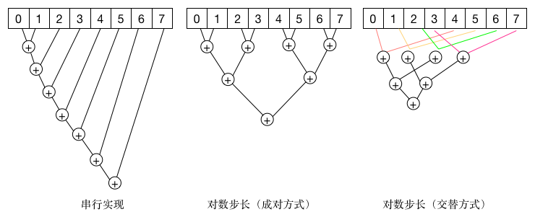
Notes:
从图中可以看到，不同的实现其时间复杂度也是不一样的，其中串行实现完成计算需要7步，性能比较差。成对的方式是典型的分治思想，只需要lgN步来计算结果，由于不能合并内存事务，这种实现在CUDA中性能较差。
在CUDA中，无论是对全局内存还是共享内存，基于交替策略效果更好。对于全局内存，使用blockDim.x*gridDim.x的倍数作为交替因子有良好的性能，因为所有的内存事务将被合并。对于共享内存，最好的性能是按照所确定的交错因子来累计部分结果，以避免存储片冲突，并保持线程块的相邻线程处于活跃状态。

Slide 13
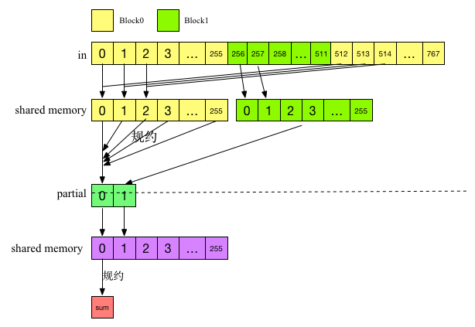
两遍规约
Notes:
该算法包含两个阶段，并且两个阶段调用同一个内核。第一阶段内核执行NumBlocks个并行规约，其中NumBlocks是指线程块数，得到一个中间结果数组。第二个阶段通过调用一个线程块对这个中间数组进行规约，从而得到最终结果。改算法的执行如下图所示：

Slide 14
Memory Access Optimization Techniques for GPUs
14

Slide 15
CUDA memory model
Thread Block
Thread Block
Shared Memory
Shared Memory
Registers
Registers
Registers
Registers
Thread
Thread
Thread
Thread
Local Memory
Local Memory
Local Memory
Local Memory
Global Memory
Constant Memory
Texture Memory
113
CUDA Programming

Slide 16
Memory access patterns
So, if a thread just needs a single float (4B), this results in 32B or 128B being moved
The GPU can pack together (coalesce) memory accesses when consecutive threads access consecutive memory addresses
●
Each memory access moves 32 or 128 consecutive bytes
–
●
– Examples follow
CUDA Programming
114

Slide 17
Caching load
Warp requests 32 aligned, consecutive 4-byte words Addresses fall within 1 cache-line
●
●
–
–
–
–
Warp needs 128 bytes
128 bytes move across the bus on a miss Bus utilization: 100%
Transactions: 1
Addresses from a warp
Memory addresses
Slide credits: Justin Luitjens, NVIDIA Corporation

Slide 18
Caching load
Warp requests 32 aligned, permuted 4-byte words Addresses fall within 1 cache-line
●
●
–
–
–
–
Warp needs 128 bytes
128 bytes move across the bus on a miss Bus utilization: 100%
Transactions: 1
Addresses from a warp
Memory addresses
Slide credits: Justin Luitjens, NVIDIA Corporation

Slide 19
Caching load
●
Warp requests 32 misaligned, consecutive 4-byte words
Addresses fall within 2 cache-lines
●
–
–
–
–
Warp needs 128 bytes
256 bytes move across the bus on misses Bus utilization: 50%
Transactions: 2
Addresses from a warp
Memory addresses
Slide credits: Justin Luitjens, NVIDIA Corporation

Slide 20
Caching load
All threads in a warp request the same 4-byte word Addresses fall within a single cache-line
●
●
–
–
–
Warp needs 4 bytes
128 bytes move across the bus on a miss Bus utilization: 3.125%
Addresses from a warp
Memory addresses
Slide credits: Justin Luitjens, NVIDIA Corporation

Slide 21
Caching load
Warp requests 32 scattered 4-byte words Addresses fall within N cache-lines
●
●
–
–
–
Warp needs 128 bytes
N ´ 128 bytes move across the bus on a miss Bus utilization: 128 / (N ´ 128)
Addresses from a warp
Memory addresses
Slide credits: Justin Luitjens, NVIDIA Corporation

Slide 22
Example
See cuda-image-rotation.cu
Device memory
A B C
D E F
G H I
●
Device memory
G
D
A
H
E
B
I
F
C
22

Slide 23
Example
See cuda-image-rotation.cu
Device memory Shared memory
●
 | B | C
A
D | E | F
G | H | I
A
23

Slide 24
Example
See cuda-image-rotation.cu
Device memory Shared memory
●
Device memory
A | B | C
D | E | F
G | H | I
G
D
A
A
H
E
B
I
F
C
24

Slide 25
Example
typedef struct { float x; float y; float z;
} point3d;
global void
compute( point3d *points, int n )
{
int i = threadIdx.x; float x = points[i].x; float y = points[i].y; float z = points[i].z;
/* use x, y, z … */
}
●
Array of Structures (AoS) containing three floats
Think x, y, z as coordinates of a set of points
Each memory transaction read data that is not used
–
●
– Low efficiency
Addresses from a warp
x | y | z | x | y | z | x | y | z | x | y | z | x | y | z | x | y | z | x | y | z | x | y | z
points[0]
25

Slide 26
Example
typedef struct { float x; float y; float z;
} point3d;
global void
compute( point3d *points, int n )
{
int i = threadIdx.x; float x = points[i].x; float y = points[i].y; float z = points[i].z;
/* use x, y, z … */
}
●
Array of Structures (AoS) containing three floats
Think x, y, z as coordinates of a set of points
Each memory transaction read data that is not used
–
●
– Low efficiency
Addresses from a warp
x | y | z | x | y | z | x | y | z | x | y | z | x | y | z | x | y | z | x | y | z | x | y | z
points[0]
26

Slide 27
Example
typedef struct { float x; float y; float z;
} point3d;
global void
compute( point3d *points, int n )
{
int i = threadIdx.x; float x = points[i].x; float y = points[i].y; float z = points[i].z;
/* use x, y, z … */
}
●
Array of Structures (AoS) containing three floats
Think x, y, z as coordinates of a set of points
Each memory transaction read data that is not used
–
●
– Low efficiency
Addresses from a warp
x | y | z | x | y | z | x | y | z | x | y | z | x | y | z | x | y | z | x | y | z | x | y | z
points[0]
27

Slide 28
Example
typedef struct { float *x; float *y; float *z;
} points3d;
global void
compute( points3d *points, int n )
{
int i = threadIdx.x; float x = points->x[i]; float y = points->y[i]; float z = points->z[i];
/* use x, y, z … */
}
●
Structure of Arrays (SoA) containing three arrays of floats
Memory accesses can now be coalesced
●
Addresses from a warp
x | x | x | x | x | x | x | x | y | y | y | y | y | y | y | y | z | z | z | z | z | z | z | z
points.x[]
28

Slide 29
Example
typedef struct { float *x; float *y; float *z;
} points3d;
global void
compute( points3d *points, int n )
{
int i = threadIdx.x; float x = points->x[i]; float y = points->y[i]; float z = points->z[i];
/* use x, y, z … */
}
●
Structure of Arrays (SoA) containing three arrays of floats
Memory accesses can now be coalesced
●
Addresses from a warp
x | x | x | x | x | x | x | x | y | y | y | y | y | y | y | y | z | z | z | z | z | z | z | z
points.x[]
29

Slide 30
Example
typedef struct { float *x; float *y; float *z;
} points3d;
global void
compute( points3d *points, int n )
{
int i = threadIdx.x; float x = points->x[i]; float y = points->y[i]; float z = points->z[i];
/* use x, y, z … */
}
●
Structure of Arrays (SoA) containing three arrays of floats
Memory accesses can now be coalesced
●
Addresses from a warp
x | x | x | x | x | x | x | x | y | y | y | y | y | y | y | y | z | z | z | z | z | z | z | z
points.x[]
30

Slide 31
GPU memory optimization guidelines
●
Try to coalesce memory accesses
–
–
–
Align starting address (may require padding)
A warp should access contiguous memory locations Restructure your data so that it is a Structure of Arrays (SoA)
Have enough concurrent accesses to saturate the bus
– Launch enough threads to maximize throughput
●
CUDA Programming
129
Slide credits: Justin Luitjens, NVIDIA Corporation

Slide 32
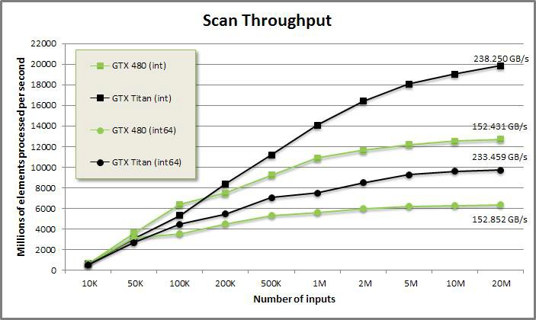
Performance Evaluation
●
We conventional concept of speedup can not be used
– The program has little or no control over the number of CUDA cores used
The hardware multiplexes CUDA threads to CUDA cores
–
●
We need different metrics, e.g.
– Throughput: number of processed data items/seconds as a function of the input size
Speedup vs CPU implementation
Source: https://moderngpu.github.io/scan.html
–
CUDA Programming
130

